Slide 1

EAD
PROJECT
Valentina Solis
- She/her
- 4th Year ENSC
- Computer Engineering
Nicholas Mah
- He/him - 4th Year ENSC
- Computer Engineering, Honours
Jonathan Wan
- He/him
- 4th Year MSE
Valentina Solis
Jonathan Wan
Nicholas Mah
Yu-Xing Lim
Yu-Xing Lim
- He/him
- 2nd Year ENSC

Slide 2
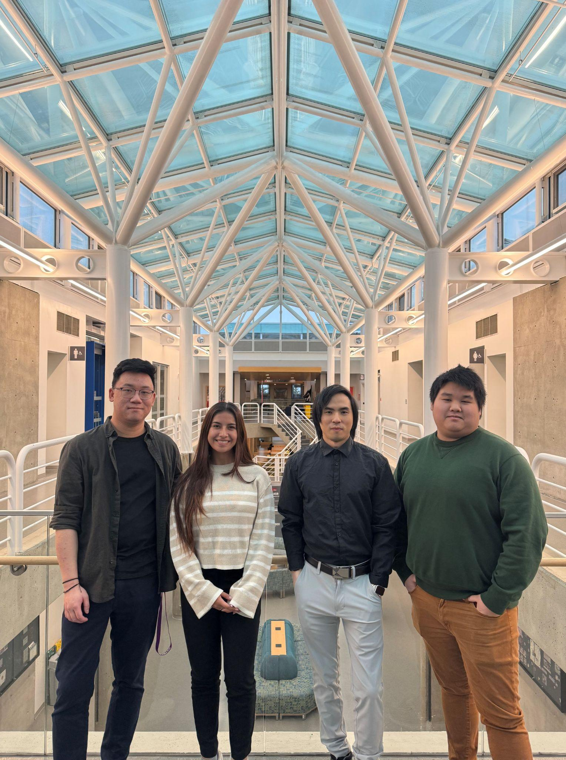
OUR TEAM
Nicholas Mah
- He/him - 4th Year ENSC
- Computer Engineering, Honours
Valentina Solis
- She/her
- 4th Year ENSC
- Computer Engineering
Jonathan Wan
- He/him
- 4th Year MSE
Yu-Xing Lim
- He/him
- 2nd Year ENSC

Slide 3
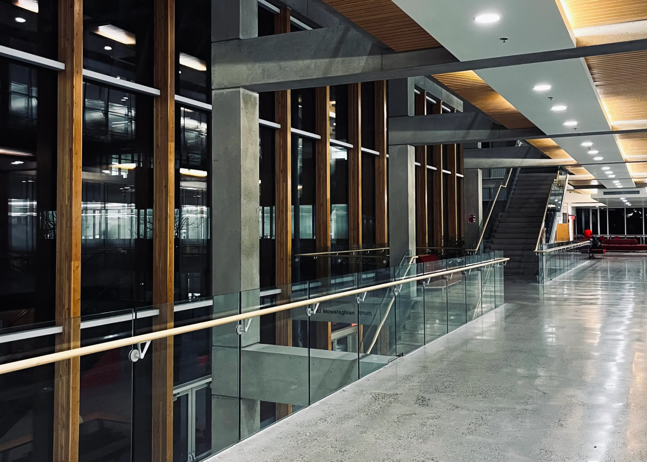

Slide 4
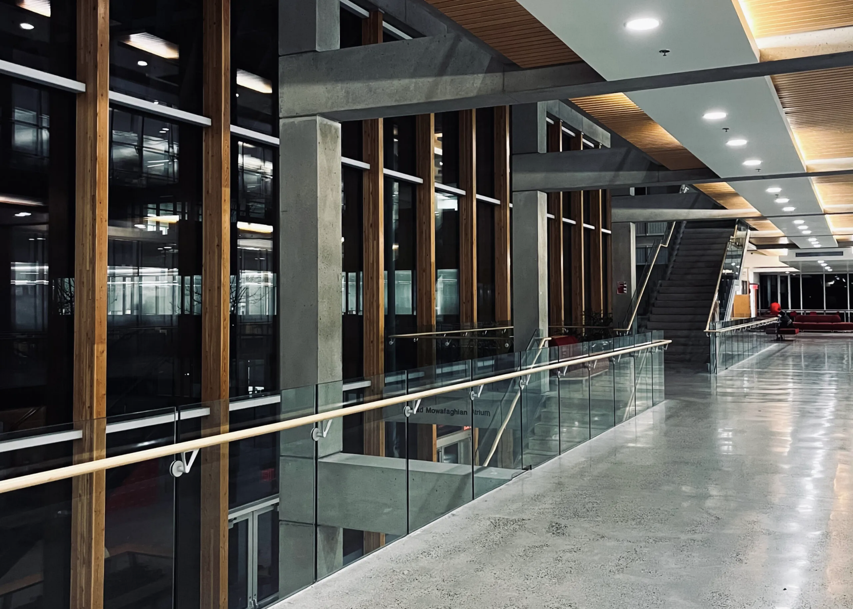
BARRIER ADDRESSED

Slide 5


BARRIER ADDRESSED
01

Slide 6
PHYSICAL ACCESSIBILITY BARRIER ADDRESSED
AUDITORY DISABILITIES
Alarms
ABOUT THE PRODUCT
Most alarms use audio cues and lights
Lights cannot always be seen
No instant notification leading to a slower response time

Slide 7

ABOUT THE PRODUCT
02

Slide 8

OUR PRODUCT
MAIN GOALS
Emergency Awareness Device
Real time device that integrates sensor technology and machine learning to immediately detect alarm signals (like fire alarms) to alert the individual through vibrations and visual notifications in a screen.
This equipment aims to enhance and reduce the gap in emergency alarm systems for people with auditory disabilities.
Notes:
While many alarm systems incorporate lights as an additional medium to alert people, depending on your location and where you’re facing, you can’t see these lights.

Slide 9
MAIN GOALS
03

Slide 10
GOAL 1
Portability and Compact Design
GOAL 2
Enhancing of Emergency Alarm Systems
PRODUCT GOALS
GOAL 3
Durability
Goal 4
Cost-Effective
Space-efficient and lightweight, making it easy to carry around in different environments and ensure personal safety at all times.
Ensures that all people, regardless of their sensory abilities, have equal access to crucial alarm signals to react at the same time.
Energy efficient for long term usage and does not break when dropped on to the ground.
Accurate and functional device with an affordable price so that it is accessible to all individuals.
Notes:
Durability: Can say we isolated components so they aren’t affected by the vibration motor, this additionally helps with durability for drop protection

Slide 11
DESIGN PROCESS
Simple
Screen
PROTOTYPE DEMO
A single button and screen allows the device to be used by anyone
Notify the user of which type of alarm is detected. We chose an OLED screen for reduced power consumption
Standalone
Vibration
Button
No phone or additional resources required
User does not need to be looking at device to be alerted
Turns off the vibration

Slide 12
PROTOTYPE DEMO
04

Slide 13
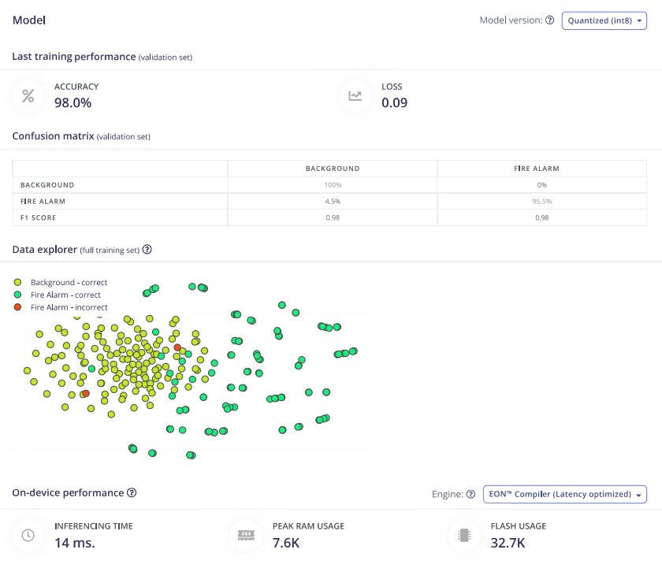
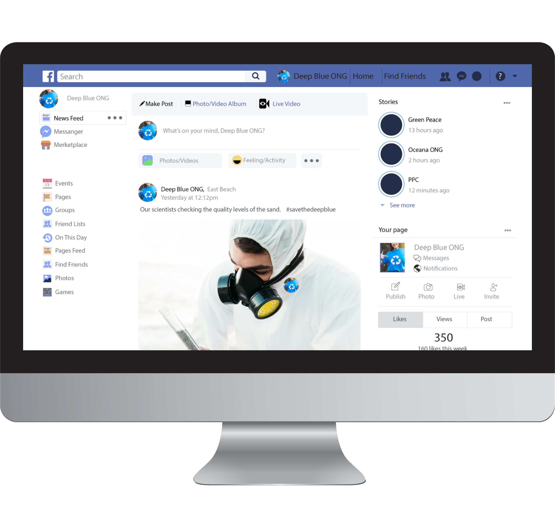

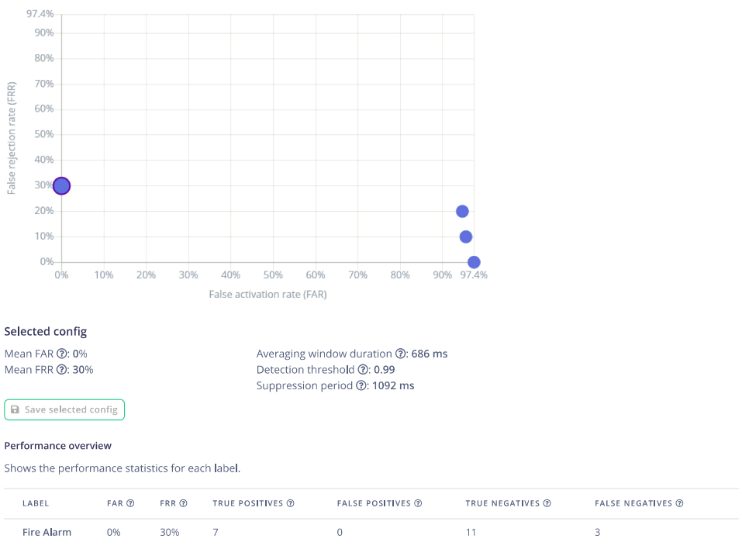
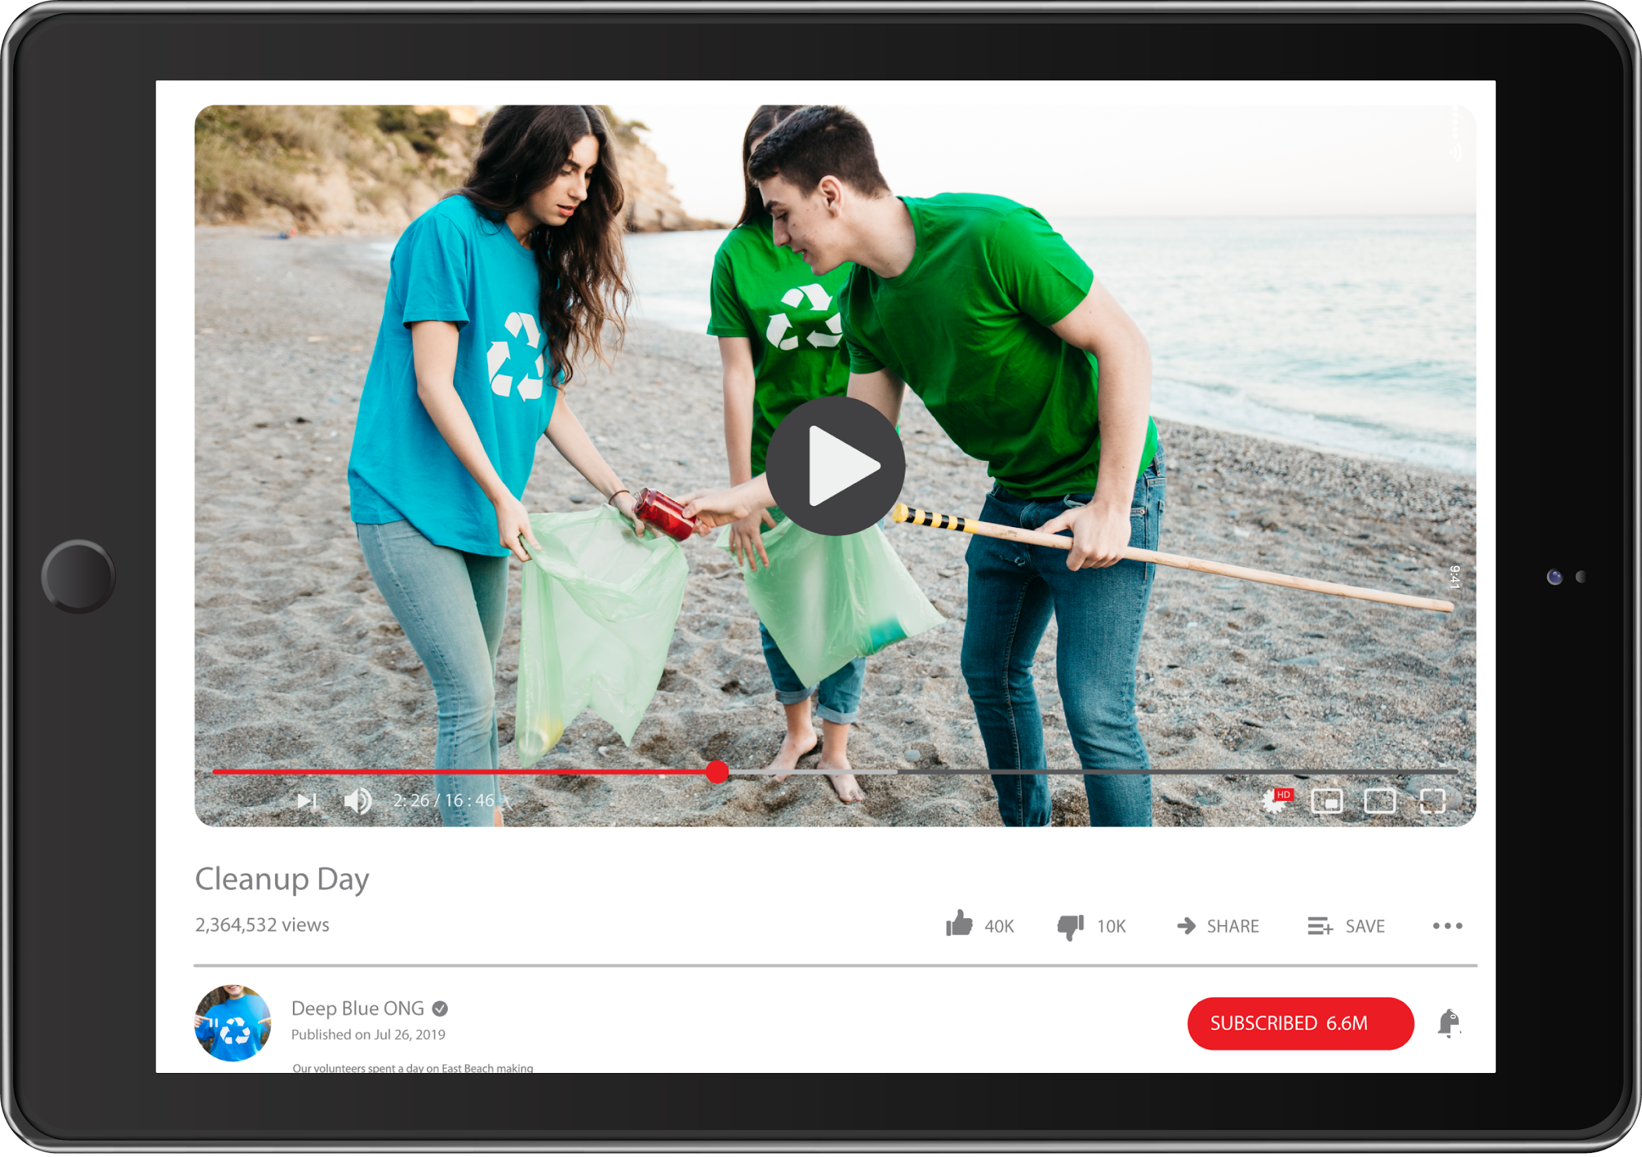
MACHINE LEARNING

Slide 14
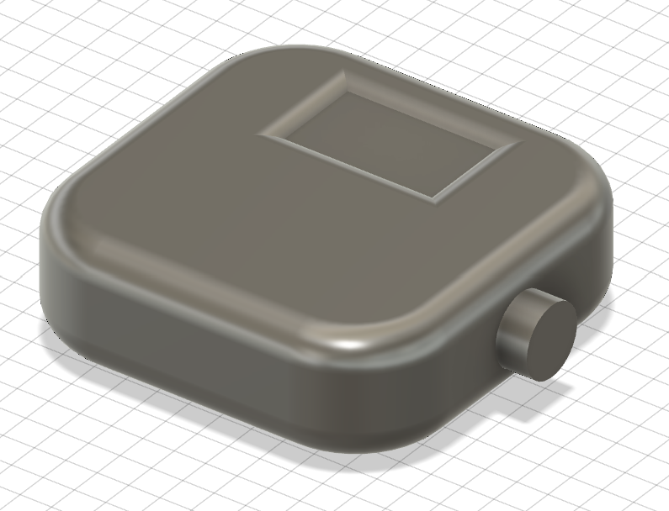
PRODUCT DESIGN
Arduino Nano 33 BLE Sense Rev2
128x64 OLED Display
3xAA Batteries

Slide 15



More Training
Reduce Size
FUTURE DEVELOPMENT
Microphone Array
Train the ML model to identify more alarm types and increase accuracy
Source or manufacture smaller components
Implement an array of sensors around the device
THANK YOU !
Valentina Solis
Jonathan Wan
Nicholas Mah
Yu-Xing Lim

Slide 16

THANK YOU !
Valentina Solis
Jonathan Wan
Nicholas Mah
Yu-Xing Lim

